Slide 1
WASHING LINE MATHEMATICS
You will need:
Some string.
Drawing pins to put the string on a wall.
A set of (laminated?) clothes.
Pegs or paper clips to put the clothes on the washing line.
Instructions:
Use the string and drawing pins to arrange several washing lines in your classroom.
Distribute a set of clothes to each group of learners.
Ask the groups to put the clothes on the washing line, in ascending order.

Slide 2
WASHING LINE MATHEMATICS
1 Fractions | Decimals | Percentages

Slide 3
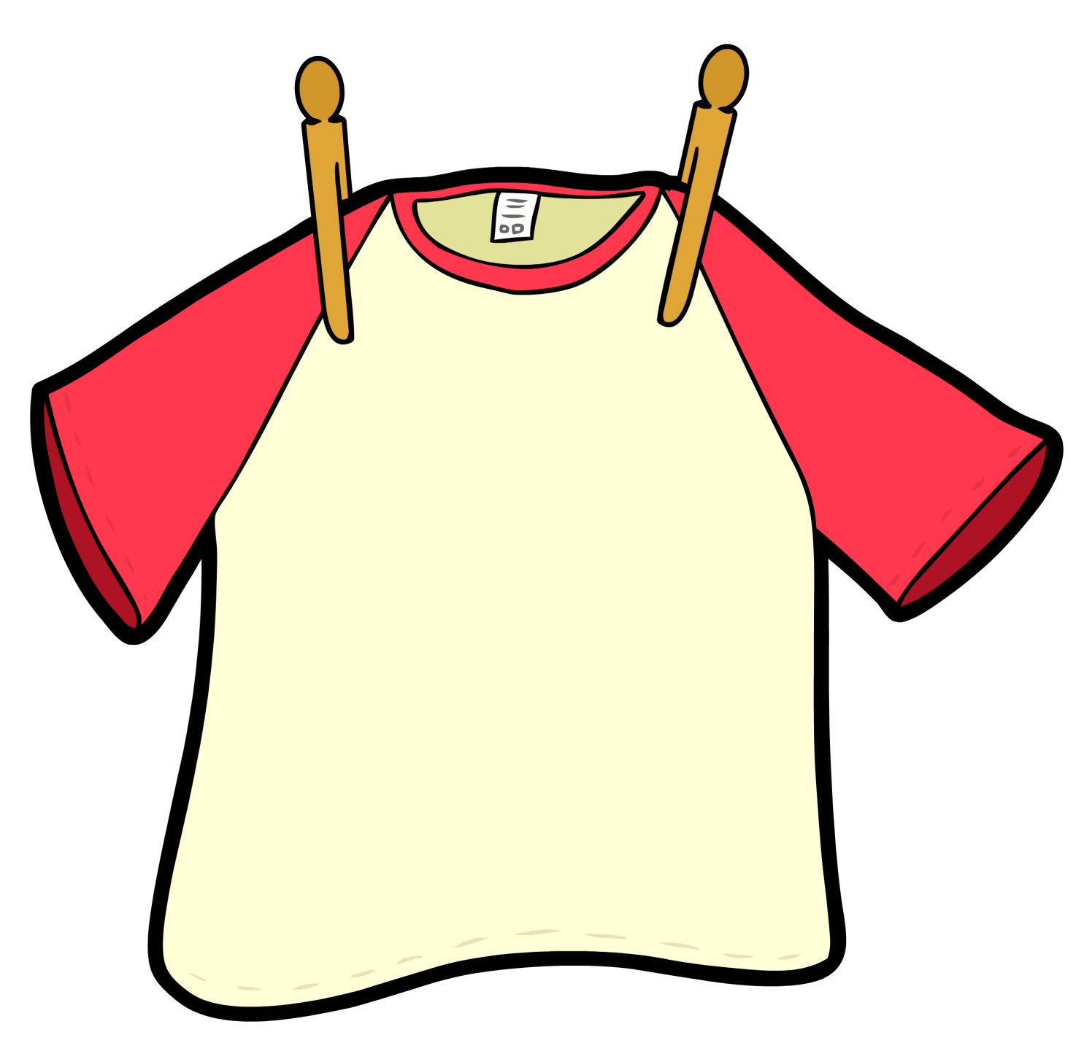
1 Fractions | Decimals | Percentages
23%
54% - 33%
0.19

Slide 4
1 Fractions | Decimals | Percentages
$$\frac{2}{5}$$ × 0.6
0.51 ÷ 3

Slide 5
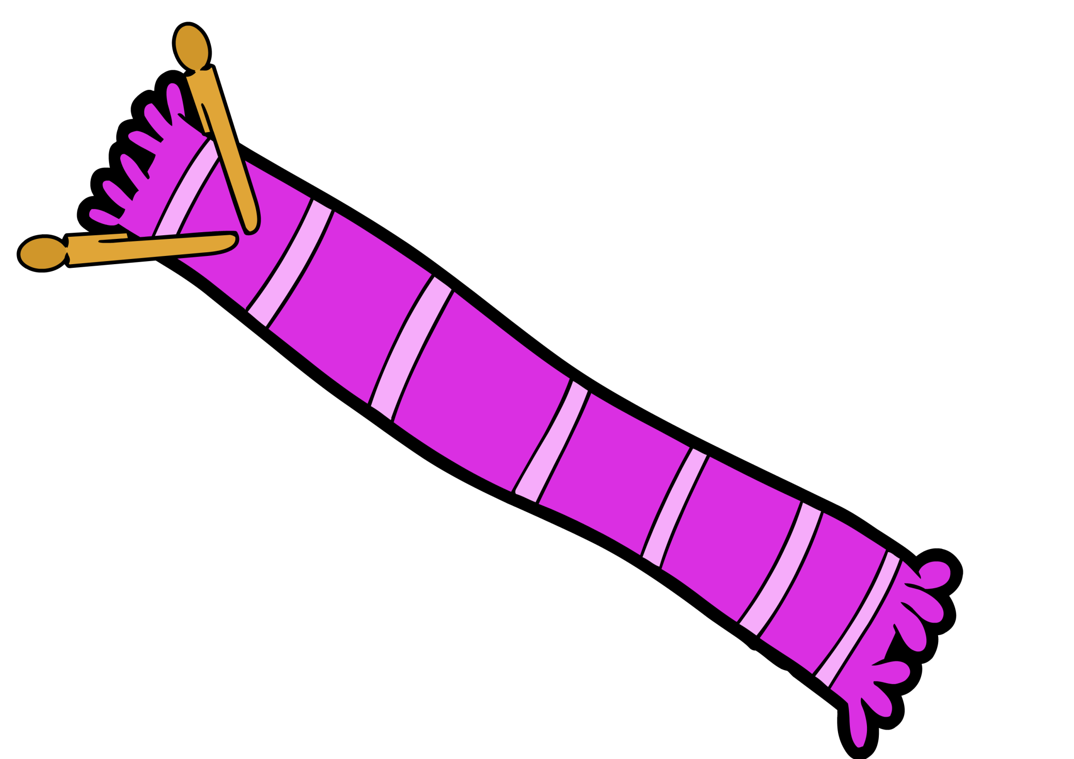
1 Fractions | Decimals | Percentages
$$\frac{9}{50}$$
$$\frac{1}{5}$$
$$\frac{3}{4}−\frac{1}{2}$$
$$\frac{3}{50}+\frac{1}{5}$$

Slide 6
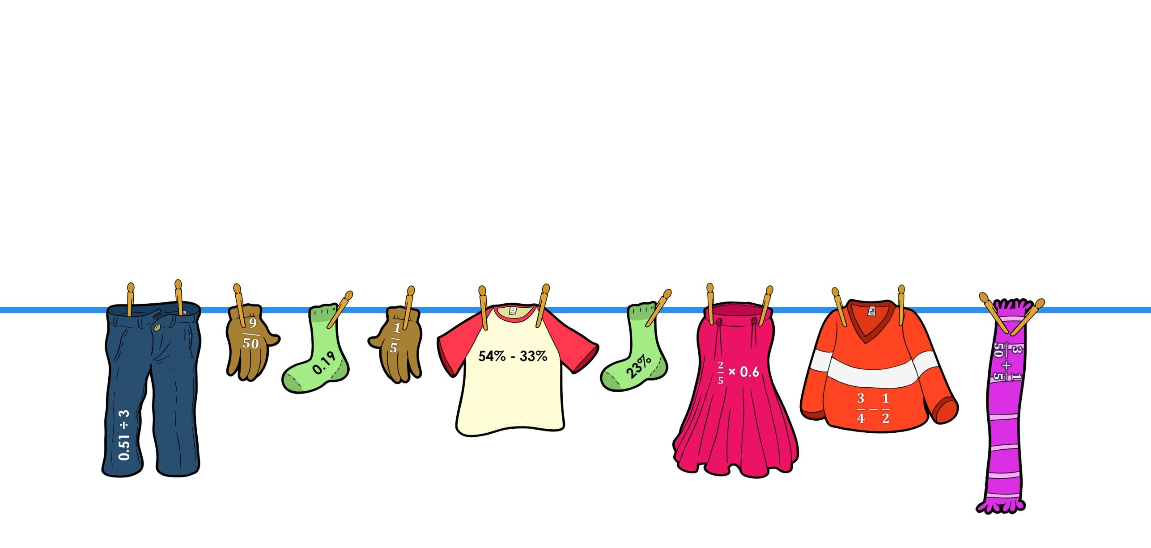
1 Fractions | Decimals | Percentages
ANSWER

Slide 7
WASHING LINE MATHEMATICS
2 Solving Equations

Slide 8
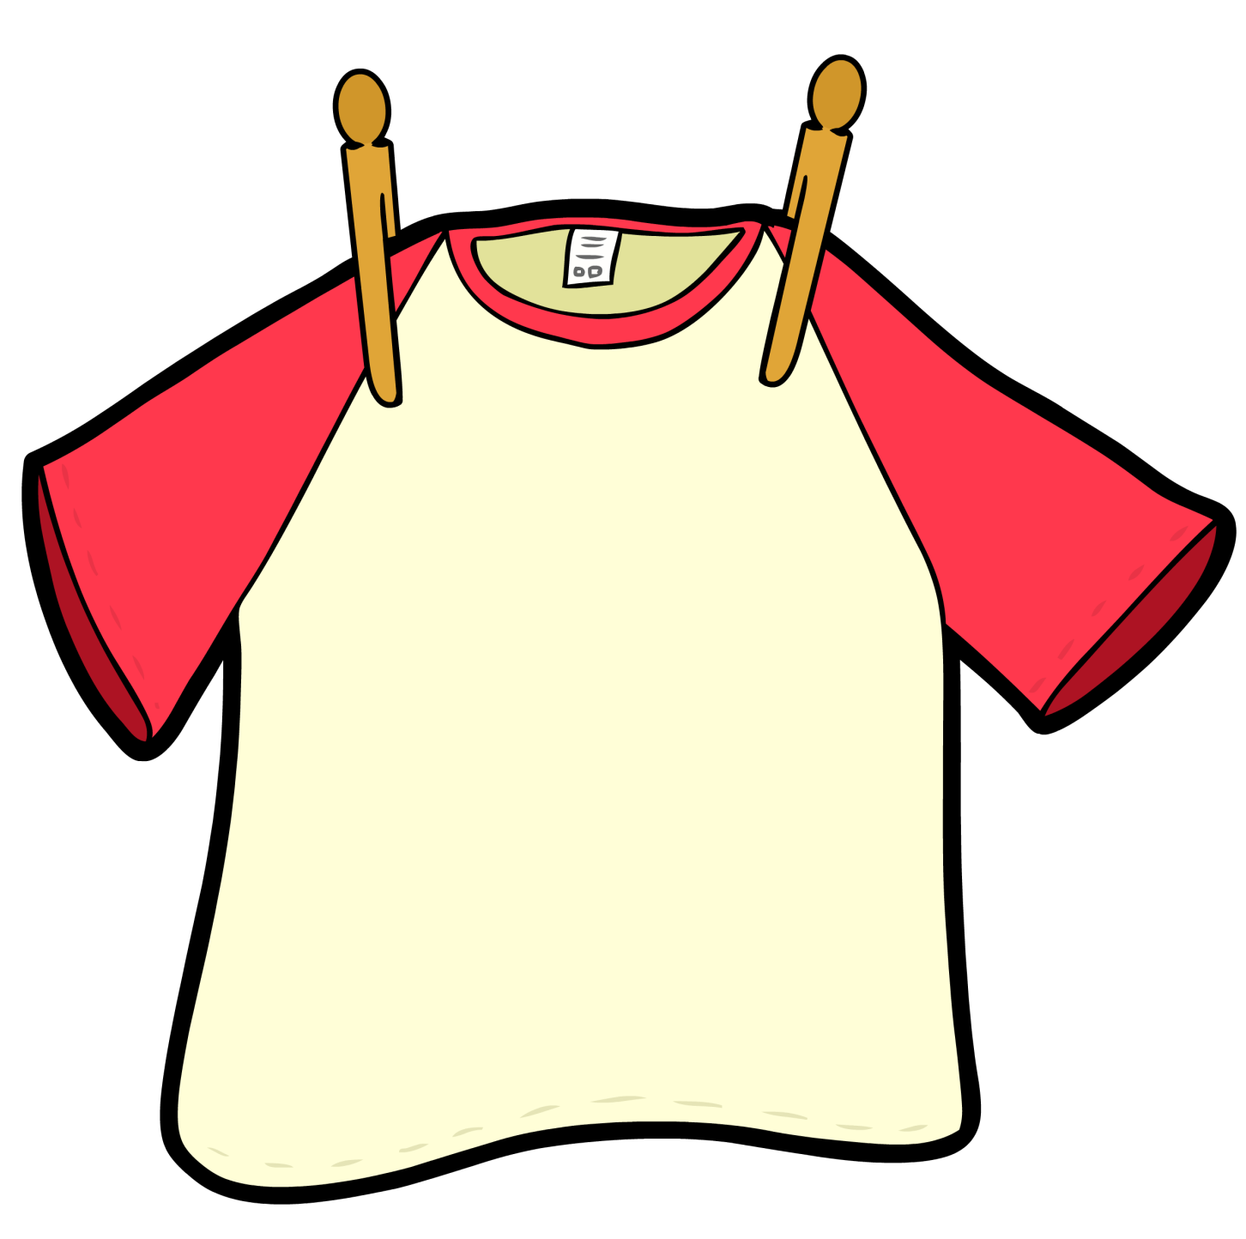
2 Solving Equations
9x = 54
5x + 3 = 2x + 12
X +4 = 13

Slide 9
2 Solving Equations
4x – 3 = 2x + 5
13x + 4 = 9x + 12

Slide 10
2 Solving Equations
5x = 65
X – 4 = 4
8x – 3 = 37
42 ÷ x = 6

Slide 11
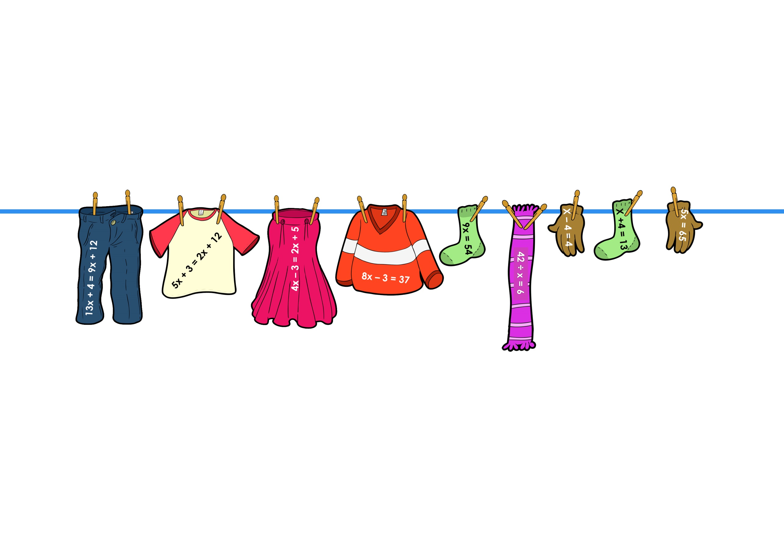
2 Solving Equations
ANSWER

Slide 12
3 Perimeter and Area

Slide 13
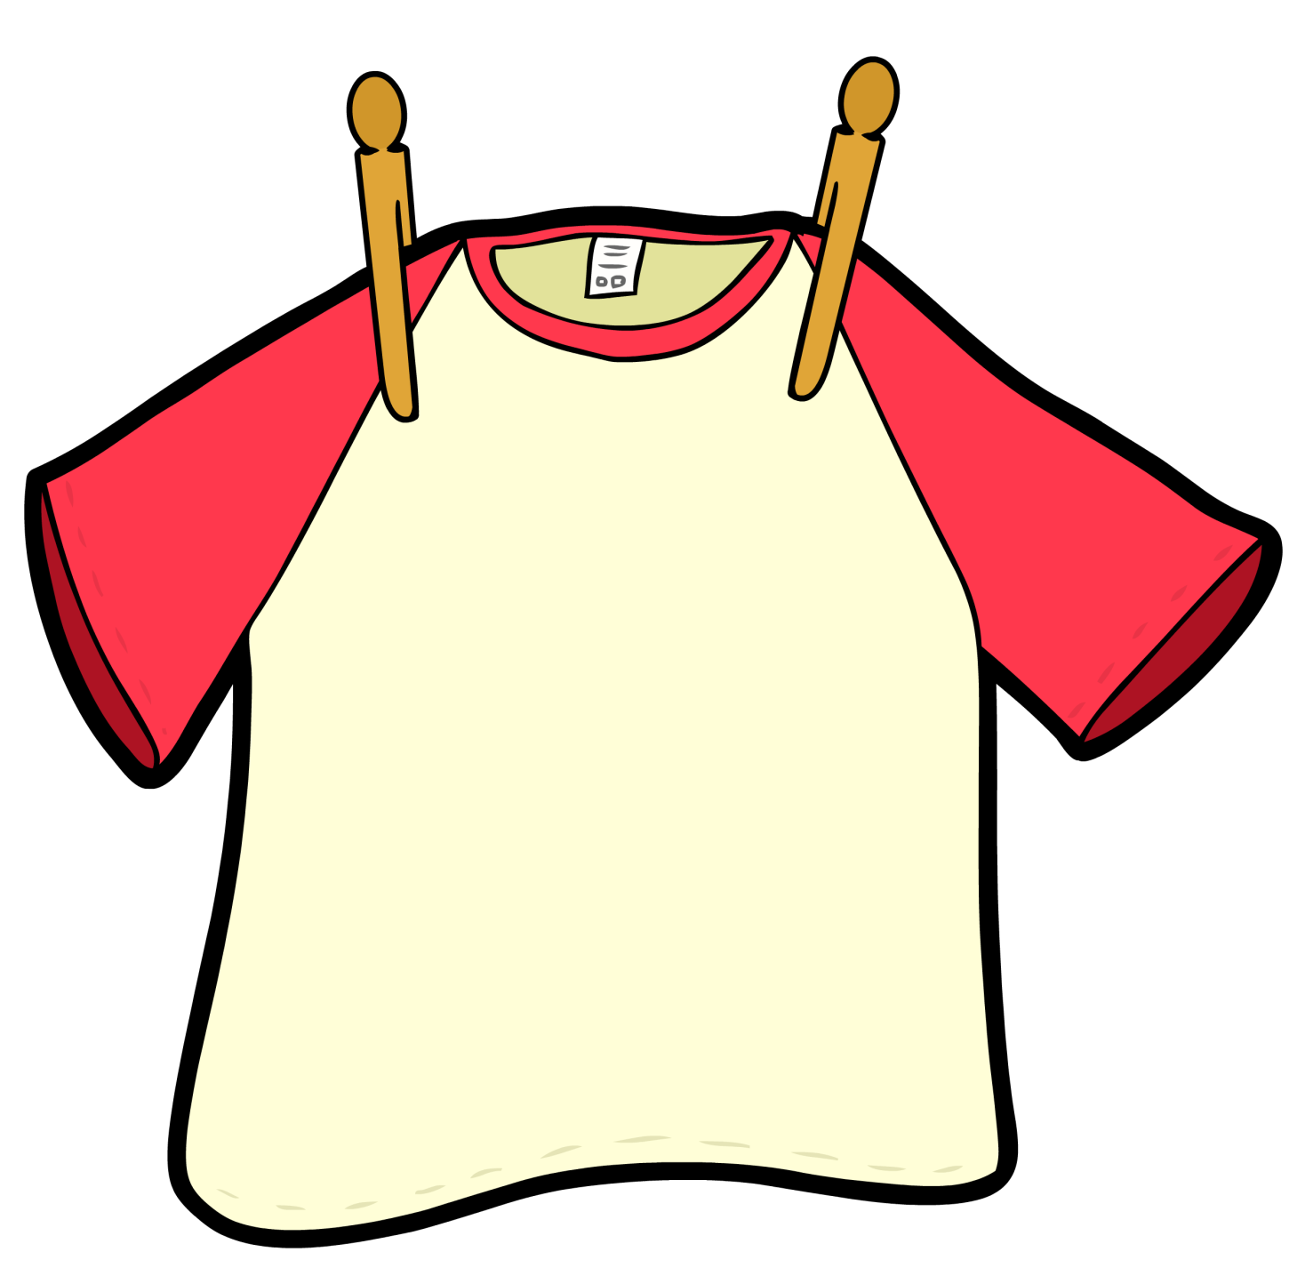
3 Perimeter and Area
Area of a
7cm × 3cm Rectangle
Perimeter of a 6cm x 5cm Rectangle
Area of a
5cm × 4cm Rectangle

Slide 14
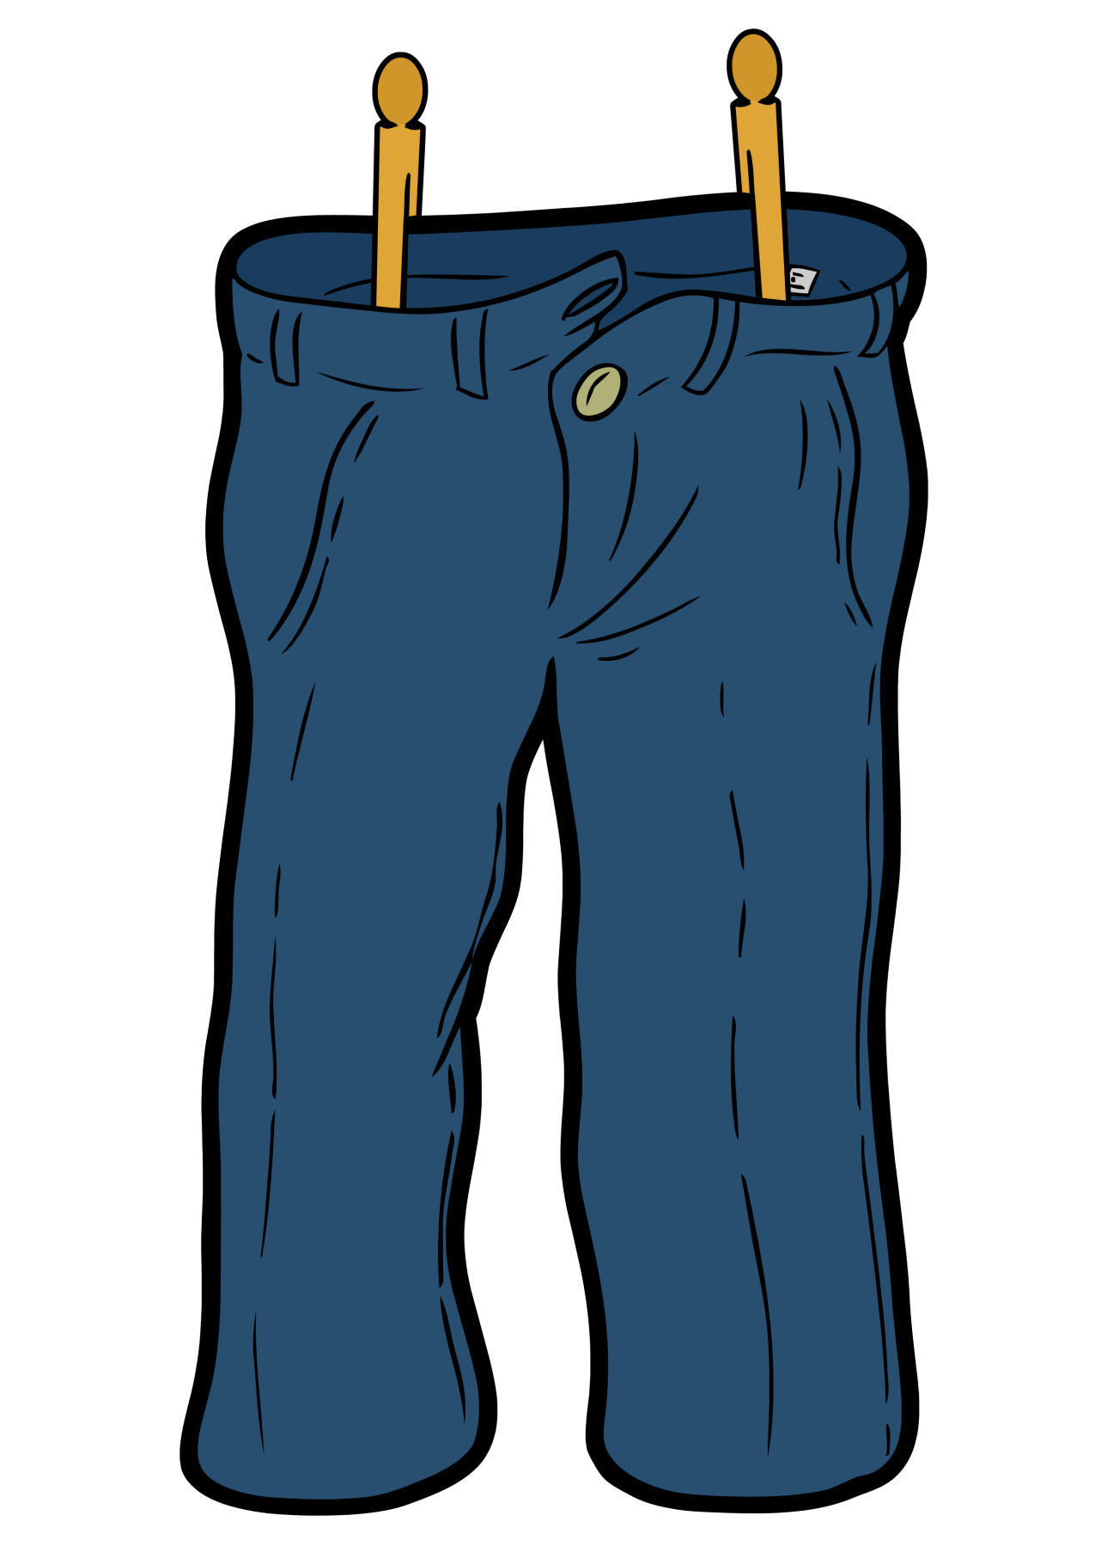
3 Perimeter and Area
Area of a right-angled triangle with base 3cm and height 12cm
Perimeter of a Regular Octagon with sides of length 3cm

Slide 15
3 Perimeter and Area
Area of a Square with 5cm sides
Perimeter of a Square with 6.5cm sides
Area of a Triangle with base 9cm
and height 6cm
Perimeter of a Regular Pentagon
with sides of length 4.6cm

Slide 16
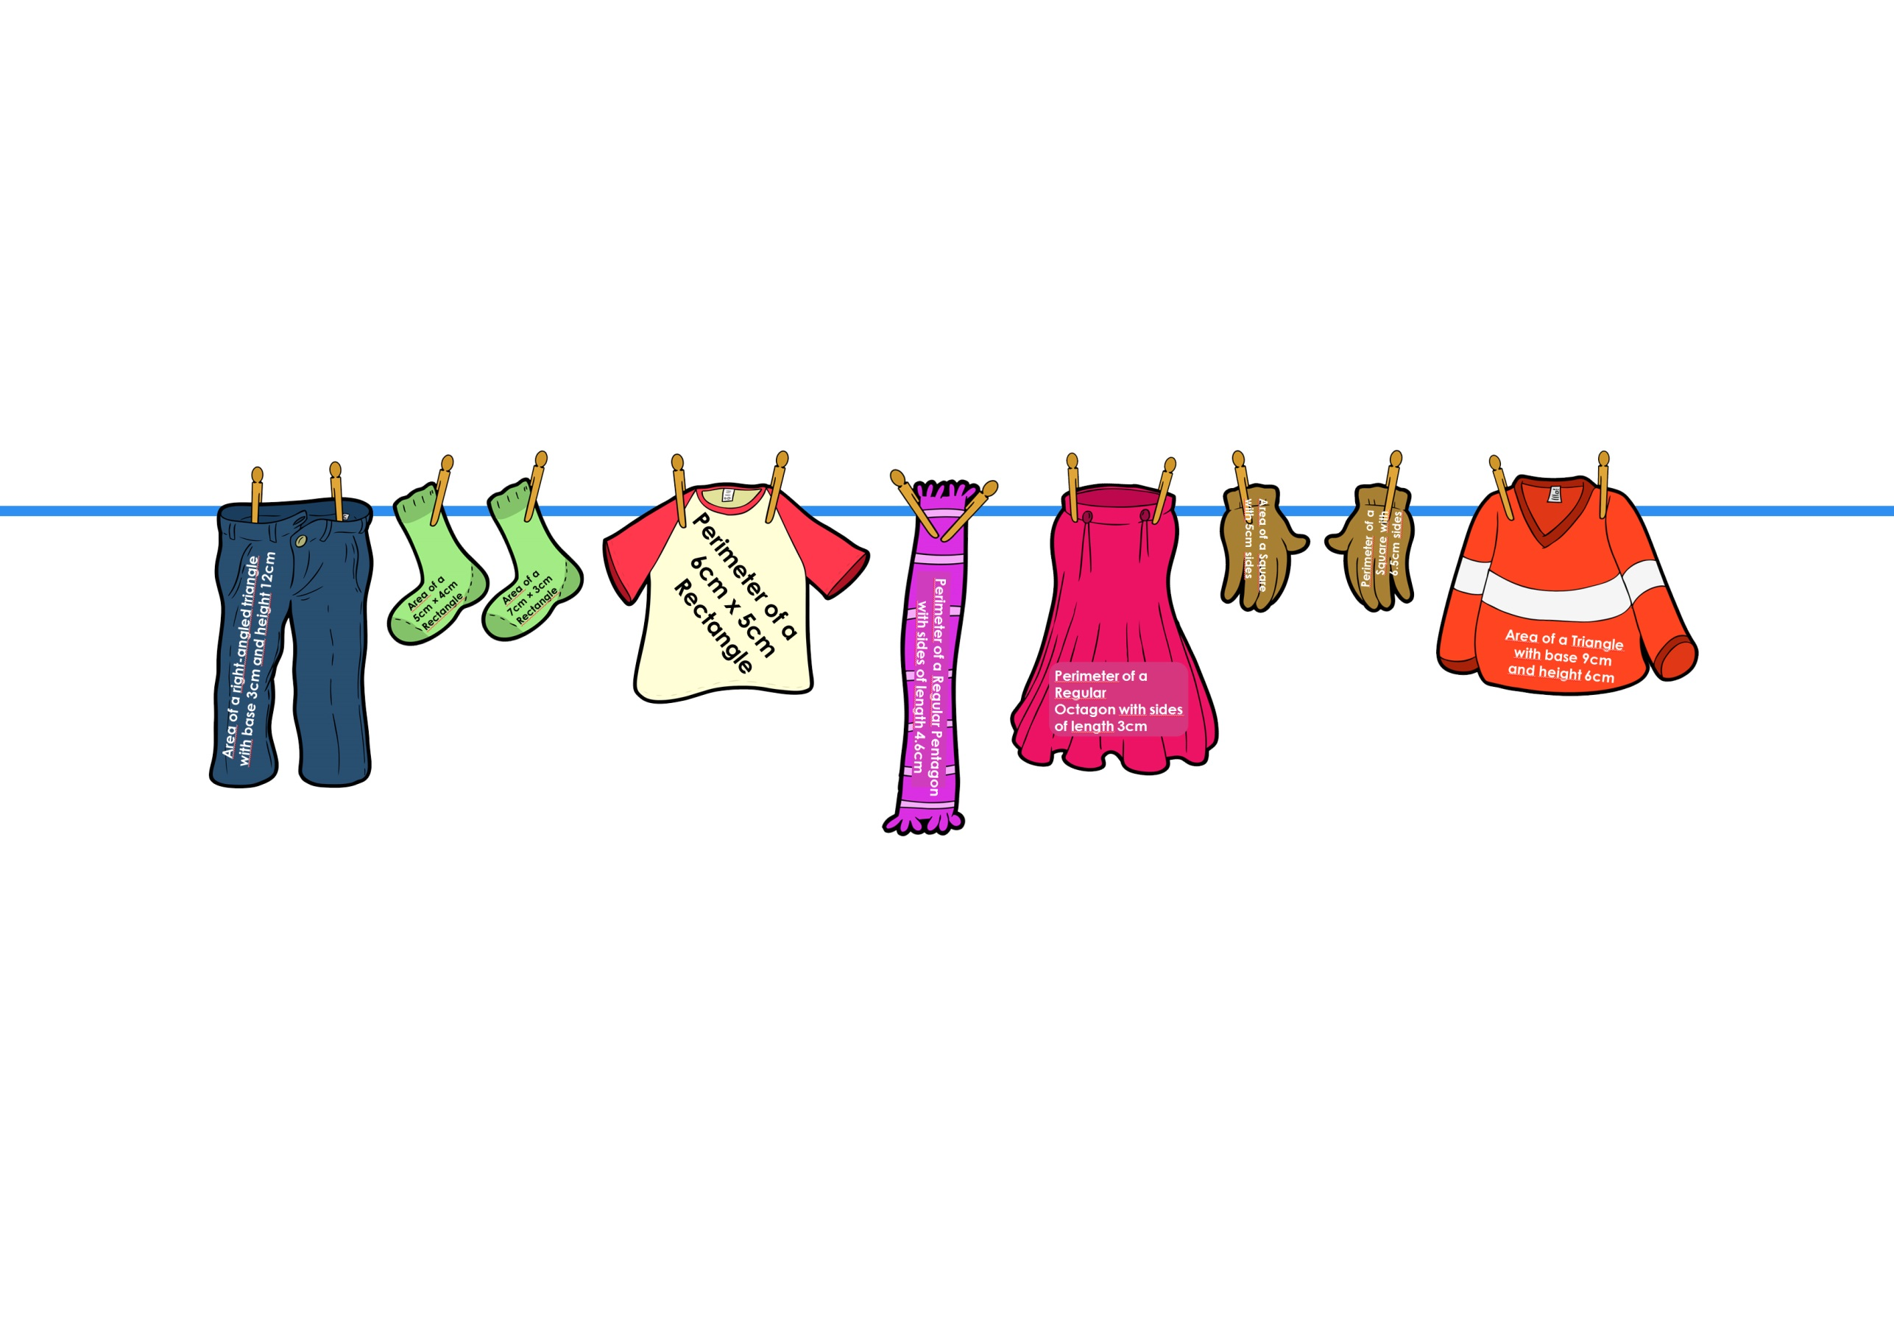
3 Perimeter and Area
ANSWER

Slide 17
4 Range and Averages

Slide 18
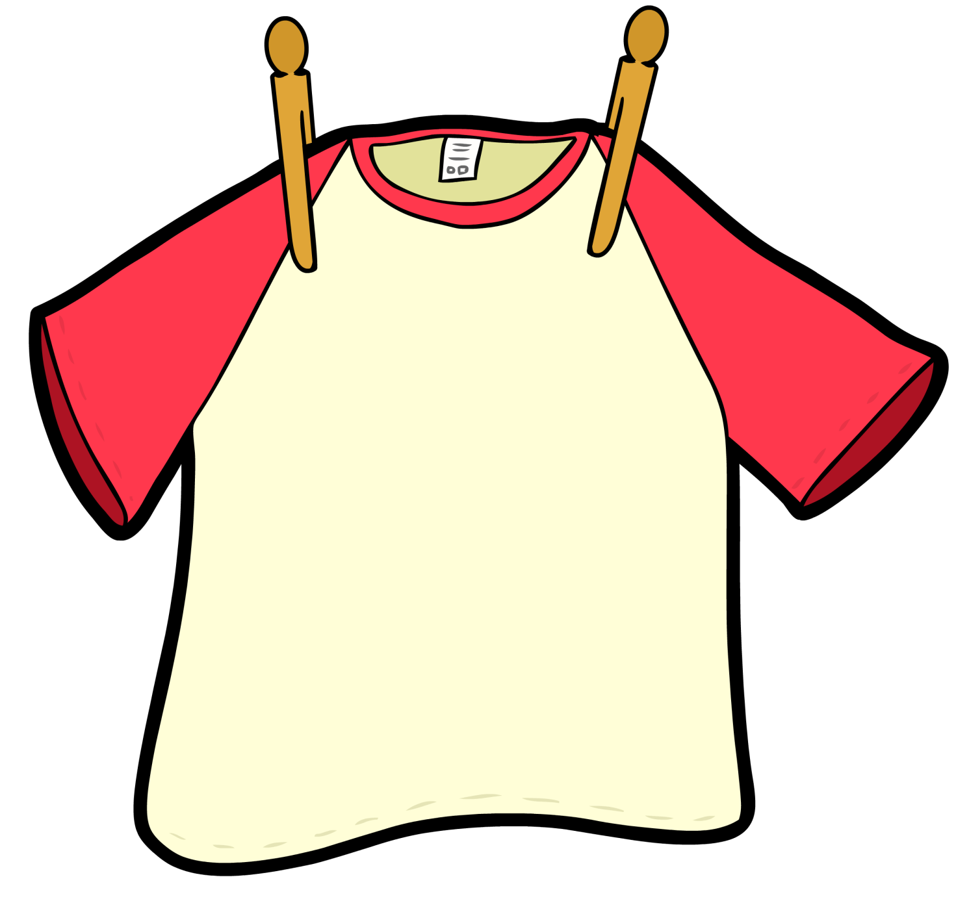
4 Range and Averages
Range 21, 25, 20, 21, 23
Mode 6, 9, 7, 8, 10, 7, 17, 9, 7, 6, 2, 8
Mean 16, 3, 2, 2, 7

Slide 19
4 Range and Averages
Median 8, 3, 5, 2, 6, 8, 15, 7, 3, 3
Mean 5, 2, 3, 6, 1, 3, 7, 1, 3, 7, 2, 3, 5, 8, 4

Slide 20
4 Range and Averages
Median9, 5, 8, 10, 8, 5, 10, 5
Range 8, 3.5, 9, 3.5, 11
Mean 6, 2, 6, 7
Mode 10, 10, 9, 9, 6, 5, 0

Slide 21
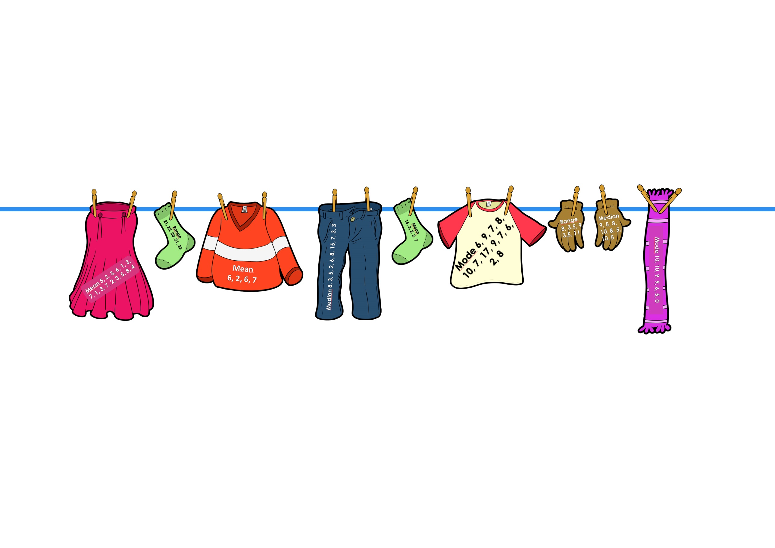
4 Range and Averages
ANSWER

